Slide 1
Disclaimer
This training resource was developed to be used with the CZ ID platform
In October, 2026, stewardship of CZ ID transitioned to UCSF and the platform was renamed to SeqtoID
These training materials are not being actively maintained and may not reflect differences between CZ ID and SeqtoID, subsequent changes to the platform, or current methods and best practices in metagenomic sequencing and analysis

Slide 2

Background models
Rapid Response – Updated Sept 2026
Notes:
Slides updated 07/02/2024

Slide 3
Exploring Results
QC metrics
Sample Report
  Metrics
  Analysis
Accounting for background

Slide 4


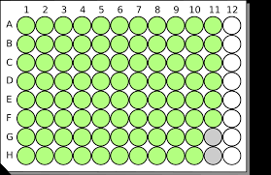



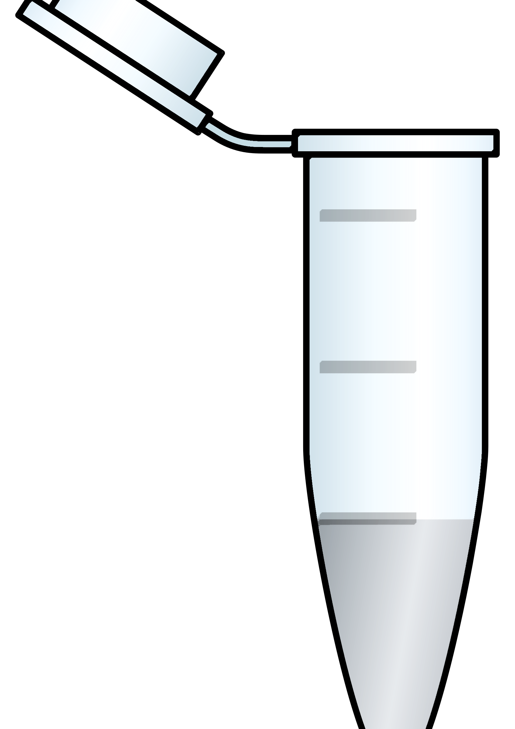
Contamination will happen!
Reagents
Lab setting
Staff/subjects
Sampling
Internal
Contamination
(cross-contamination)
External Contamination
Notes:
There are multiple opportunities for contamination during sample processing and sequencing.

Slide 5
Contamination can lead to inaccurate data interpretation
Falsely inflates within-sample diversity
Obscures differences between samples
Interferes with comparisons across studies

Slide 6
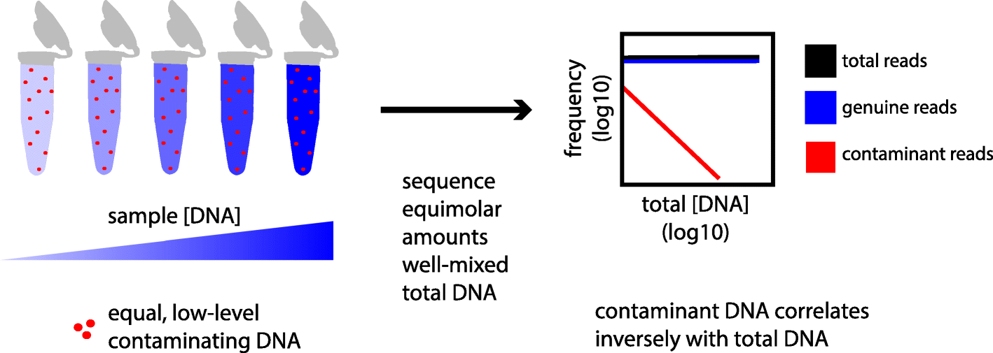
Contamination disproportionately affects low-biomass samples
Davis et. al., 2018

Slide 7
Water controls can help
‘Blanks’ such as water controls can help identify both internal and external contaminants
Water controls should be processed the same way as the samples, using the the same reagents
  Have at least 2 water controls, but the more the better!

Slide 8
Background model
Used to calculate relative abundance of the taxa found in negative controls
Background model based on relative abundance metric:
    Uses the bases per million (bpm) as the metric of relative abundance.
Notes:
Mass normalized is more sensitive so use it when you can (ERCC)

Slide 9
Background model enables Z-score calculation
Z-score
  Measurement that describes a value's relationship to the mean of a group of values
    How does the abundance of a taxon in a sample compare to its mean abundance in negative controls?

Slide 10
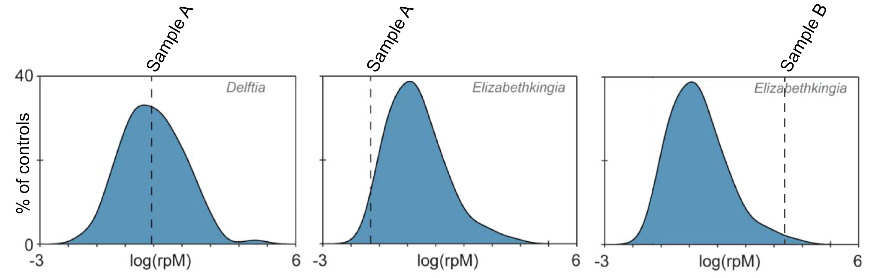
Background distribution
overlaid with sample taxa abundance
Abundance in potentially infectious sample
Distribution of abundance in controls
Notes:
Purpose of the background model is to create a distribution of that taxa in the negative controls
Then see where the sample falls within that distribution

Slide 11
Background model enables Z-score calculation
Z-score
  Measurement that describes a value's relationship to the mean of a group of values
    How does the abundance of a taxon in a sample compare to its mean abundance in negative controls?
  It is measured in terms of standard deviations from the mean
Notes:
Go to next slide for equation discussion

Slide 12
x = taxon abundance in sample
µ = taxon mean abundance in negative controls (background model)
𝝈 = standard deviation of taxon abundance in negative controls (background model)
𝛧-score linear scale:
0
Notes:
Transition: what happens when the sample has the same abundance as the background (negative controls)? See next slide for answer

Slide 13
x = taxon abundance in sample
µ = taxon mean abundance in negative controls (background model)
𝝈 = standard deviation of taxon abundance in negative controls (background model)
No difference
𝛧 = 0
Notes:
Think through: What happens if it’s higher in your negative control? (See next slide for answer)

Slide 14
x = taxon abundance in sample
µ = taxon mean abundance in negative controls (background model)
𝝈 = standard deviation of taxon abundance in negative controls (background model)
No difference
𝛧 < 0
𝛧 = 0
Taxa more abundant in negative controls than in samples
Notes:
Think through: What happens if it’s higher in your sample? (See next slide for answer)

Slide 15
x = taxon abundance in sample
µ = taxon mean abundance in negative controls (background model)
𝝈 = standard deviation of taxon abundance in negative controls (background model)
No difference
𝛧 < 0
𝛧 = 0
𝛧 > 0
Taxa more abundant in negative controls than in samples
Taxa more abundant in samples than negative controls

Slide 16
x = taxon abundance in sample
µ = taxon mean abundance in negative controls (background model)
𝝈 = standard deviation of taxon abundance in negative controls (background model)
Only in control
No difference
Only in sample
-100
0
100
Taxa more abundant in negative controls than in samples
Taxa more abundant in samples than negative controls

Slide 17
Use Z-score filter after applying background model
Start with taxa with Z-scores > 1
Only in control
Only in sample
-100
0
100
Taxa more abundant in negative controls than in samples
Taxa more abundant in samples than negative controls

Slide 18
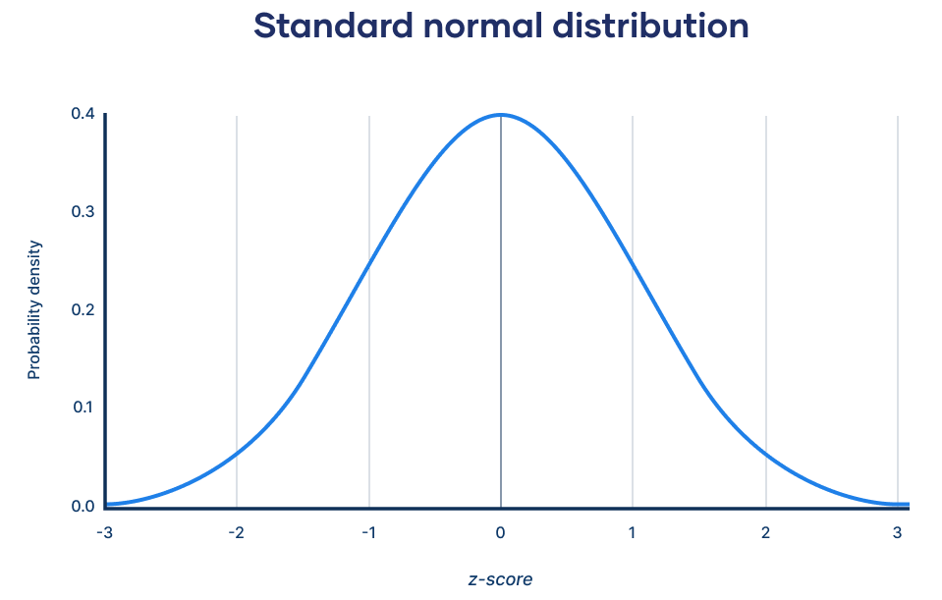
Use Z-score filter after applying background model
Start with taxa with Z-scores > 1

Slide 19
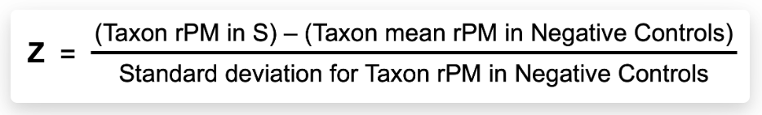
Calculating Z-score
Standard Z-score calculation for sample “S”:
Notes:
Actual equations used in CZ ID

Slide 20
Additional controls
Controls can also be used to create a background model to identify pathogens of interest (for example, cases vs controls)
Sample controls can also be used to identify contaminants from sampling, but can be difficult to come by
Background models can be applied to the sample report and the heatmap

Slide 21
Let’s make a background model!
Option 1 (outlined in worksheet): simple, subtract average signal in water controls from signal found in sample
Option 2 (shown in this slide deck): calculate a Z score for each taxa within each sample, using the equation outlined above

Slide 22
Go to reports and look at the water controls
Are your candidate taxa present in the water controls?
If so, at what level?
How does this compare to the level seen in your sample?
Subtract the background / water control signal from the sample signal for each taxa
Interpret: real signal should be higher in samples than in water controls

Slide 23
Example

Slide 24
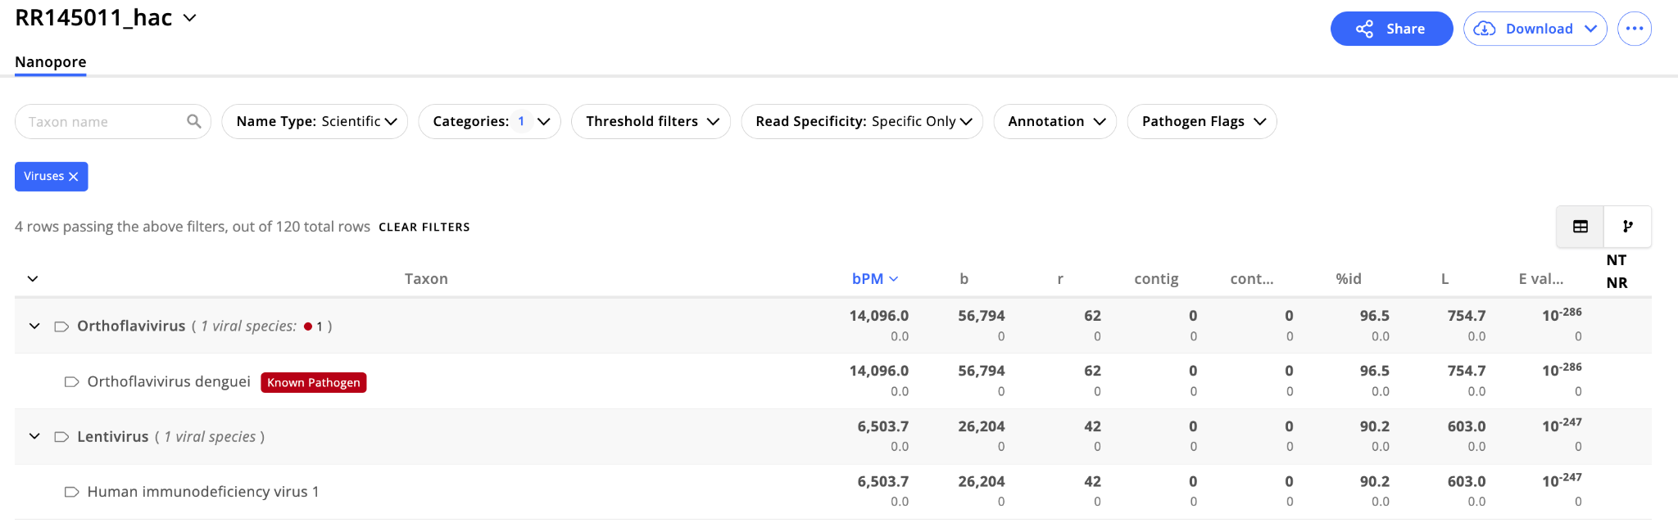
Example: serum sample from VHF-suspect samples
Suspected sample
Notes:
https://docs.google.com/spreadsheets/d/15B7DRydG2sRDtqkaHDDvFo9wBsMnblrx/edit?gid=1312992723#gid=1312992723

Slide 25
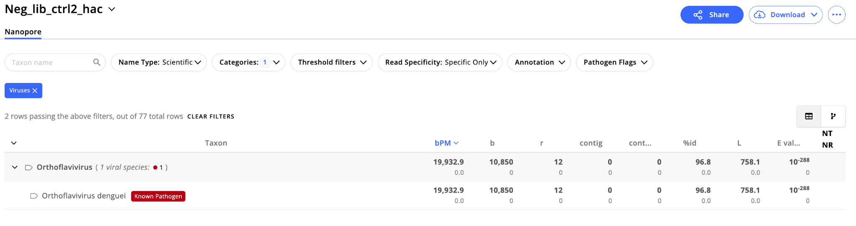
Example: serum sample from VHF-suspect samples
Water control
Notes:
https://docs.google.com/spreadsheets/d/15B7DRydG2sRDtqkaHDDvFo9wBsMnblrx/edit?gid=1312992723#gid=1312992723

Slide 26
Example: serum sample from VHF-suspect samples
Suspected sample
Water control
Notes:
https://docs.google.com/spreadsheets/d/15B7DRydG2sRDtqkaHDDvFo9wBsMnblrx/edit?gid=1312992723#gid=1312992723

Slide 27
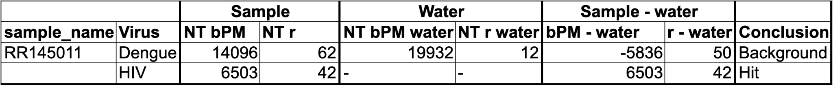
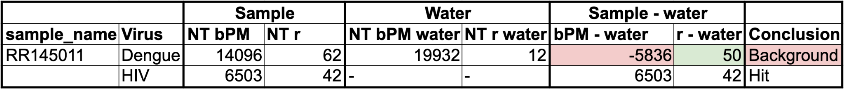
Serum library has high signal from barcode bleeding
Subtracting background signal was necessary to help with interpretation and reduce false positives
Notes:
https://docs.google.com/spreadsheets/d/15B7DRydG2sRDtqkaHDDvFo9wBsMnblrx/edit?gid=1312992723#gid=1312992723

Slide 28
Example report - background subtraction necessary for accurate calls
This DENV is background / barcode hopping
Subtracting background signal was necessary for some samples to help with interpretation and reduce false positives
Notes:
https://docs.google.com/spreadsheets/d/15B7DRydG2sRDtqkaHDDvFo9wBsMnblrx/edit?gid=1312992723#gid=1312992723

Slide 29
Analysis Workflow - ONT
Complete a first pass sample report view
Look at the list of detected taxa
Record NT bPM, NT r, and any other relevant metrics
Look at the coverage plot for each taxa and record your interpretation (low, medium, high coverage)
BLASTn contigs from each candidate taxa and record what you find (specific, non-specific, etc)
Check negative water controls
Navigate to the sample report for each negative water control included in the run
For each taxa observed in the samples, record the NT bPM, NT r, and any other metrics in each water control
If you have >1 water control, calculate the average signal for each taxa
Put it all together (background subtraction + interpretation)
Subtract the background/water control signal from the sample signal for each taxa
Interpret: real signal should be higher in samples than in water controls

Slide 30
Analysis Workflow - ONT
Complete a first pass sample report view
Look at the list of detected taxa
Record NT bPM, NT r, and any other relevant metrics
Look at the coverage plot for each taxa and record your interpretation (low, medium, high coverage)
BLASTn contigs from each candidate taxa and record what you find (specific, non-specific, etc)
Check negative water controls
Navigate to the sample report for each negative water control included in the run
For each taxa observed in the samples, record the NT bPM, NT r, and any other metrics in each water control
If you have >1 water control, calculate the average signal for each taxa
Put it all together (background subtraction + interpretation)
Subtract the background/water control signal from the sample signal for each taxa
Interpret: real signal should be higher in samples than in water controls

Slide 31
Go to worksheet: Identification of background signal
Worksheet: CZ ID Training Reference Tables & Worksheets_ONT, pg 17-20

